Slide 1

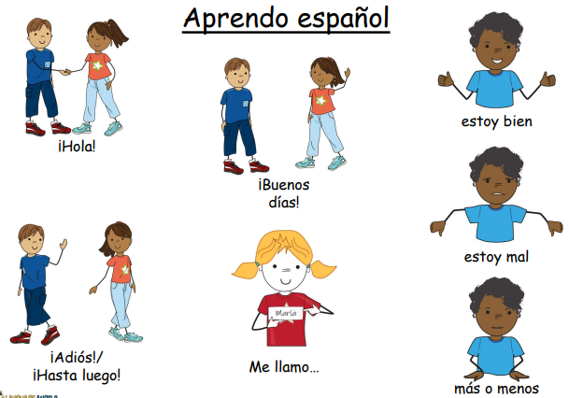
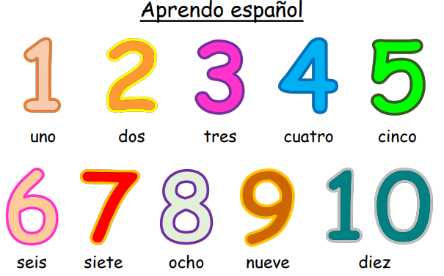
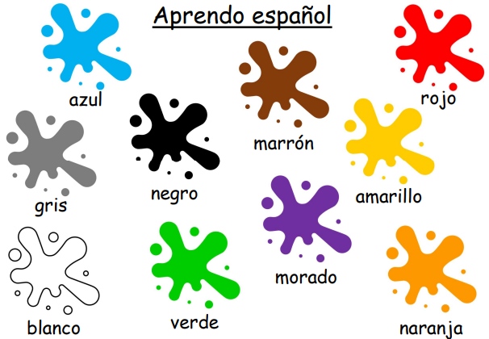
MFL knowledge organiser Y3 Autumn 1: I am learning Spanish
Key knowledge
To locate Spain, Madrid and a few key cities on a map.
To say our name.
To say how we are feeling.
To learn up to 10 colours.
To count from 1-10 in Spanish.
Key vocabulary | Key vocabulary | Key vocabulary
Simple greetings ¡Hola! ¡Buenos días! estoy bien estoy mal más o menos ¡Adiós! / ¡Hasta luego! Me llamo… | Numbers uno dos tres cuatro cinco seis siete ocho nueve Diez | Colours Amarillo Naranja Marrón Verde Blanco Gris Azul Negro Morado Rojo
Prior knowledge | Children know that Spain is a country in Europe

Slide 2
MFL knowledge organiser Y3 Autumn 2: Colours and numbers
Key knowledge
To learn up to 10 colours.
To count from 1-10 in Spanish.
Key vocabulary | Key vocabulary
Numbers uno dos tres cuatro cinco seis siete ocho nueve Diez | Colours Amarillo Naranja Marrón Verde Blanco Gris Azul Negro Morado Rojo
Prior knowledge | I am learning Spanish unit – colours and numbers

Slide 3
MFL knowledge organiser Y3 Spring 1: Greetings
Key knowledge
Say ‘hello’ (formally and informally) in Spanish.
Say ‘my name is…’ in Spanish.
Ask somebody in Spanish how they are feeling and give a reply.
Say ‘goodbye’ and ‘see you soon’ in Spanish.
Key vocabulary | Key vocabulary
¡Buenos días! Good morning! ¿Cómo estás? How are you? ¡Hola! Hello/Hi! Estoy bien. I am well/good. ¡Adiós! Goodbye! | Estoy mal. I am not well/not great. ¡Hasta luego! See you soon! Más o menos. So so. Me llamo… My name is…Los saludos Greetings/Salutations
Prior knowledge | I am learning Spanish unit – greetings

Slide 4
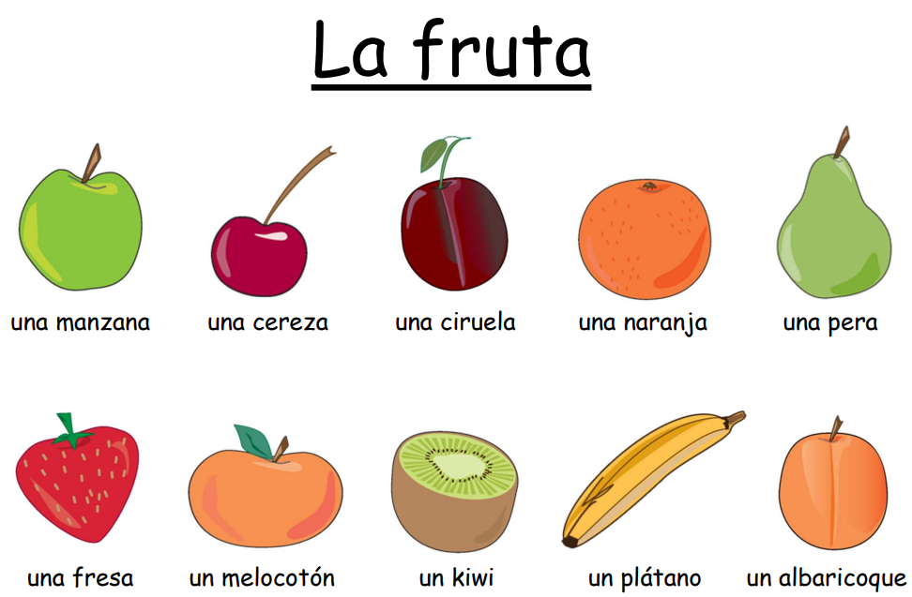
MFL knowledge organiser Y3 Spring 2: Fruit
Key knowledge
Name, recognise and remember up to 10 fruits in Spanish.
Attempt to spell some of these nouns with their correct article/determiner.
Ask somebody in Spanish if they like a particular fruit.
Say what fruits we like and dislike in Spanish.
Key vocabulary | Key vocabulary
una manzana - an apple las manzanas - the apples una fresa - a strawberry las fresas - the strawberries un melocotón - a peach los melocotones - the peaches un plátano - a banana los plátanos - the bananas una cereza - a cherry las cerezas - the cherries una naranja - an orange | las naranjas - the oranges una ciruela - a plum las ciruelas - the plums una pera - a pear las peras - the pears un kiwi - a kiwi los kiwis - the kiwis un albaricoque - an apricot los albaricoques - the apricots Me gustan… I like… No me gustan… I do not like…
Prior knowledge | Greetings
 | Colours
 | Numbers

Slide 5
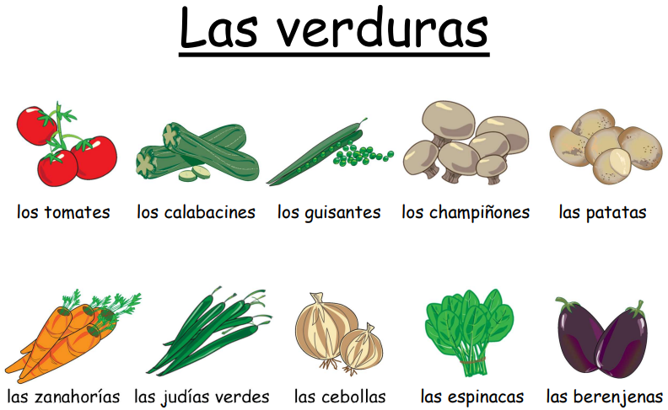
MFL knowledge organiser Y3 Summer 1: Vegetables
Key knowledge
Name, recognise and recall from memory up to 10 vegetables in Spanish.
Attempt to spell some of these nouns with their plural article/determiner.
Learn and use the high frequency verb quisiera from the verb querer, to want in Spanish.
Key vocabulary | Key vocabulary
los guisantes - the peas las judías verdes - the green beans las berenjenas - the aubergines un kilo de… one kilo of… las espinacas - the spinach medio kilo de… half a kilo of… las cebollas - the onions Quisiera... I would like... los calabacines - the courgettes por favor - please los tomates - the tomatoes y - and | ¡Hola! Hello! ¿Puedo ayudarte? - Can I help you? los champiñones - the mushrooms ¿Algo más? - Is that all/anything else? las zanahorias - the carrots ¿Cuánto cuesta? - How much is that? las patatas - the potatoes gracias - thank you ¡Hasta luego! Goodbye! En mi cesta tengo… - In my basket I have…
Prior knowledge | Greetings
 | Colours
 | Numbers

Slide 6
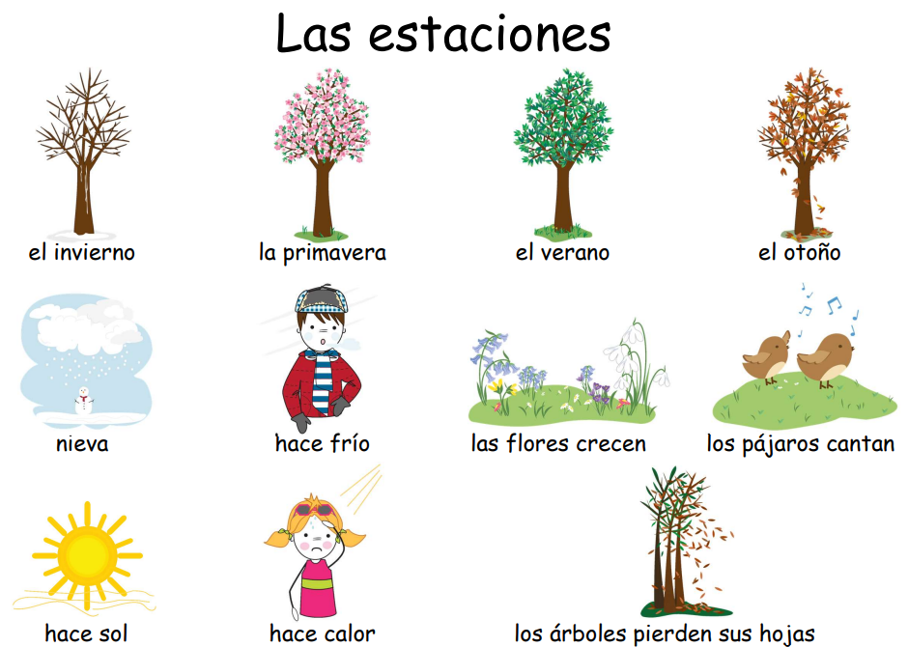
MFL knowledge organiser Y3 Summer 2: Seasons
Key knowledge
Recognise all four seasons in Spanish.
Learn an associated action for each season in Spanish.
Understand better what happens in the world around us in each season in Spanish.
Key vocabulary
las estaciones - the seasons hace frío - it is cold el invierno - winter hace calor - it is hot la primavera - spring nieva - it snows el verano - summer hace sol - it is sunny el otoño - autumn las flores crecen - the flowers grow las pájaros - cantan the birds sing los árboles pierden sus hojas - the trees lose their leaves
Prior knowledge | Greetings
 | Colours
 | Numbers

Slide 7
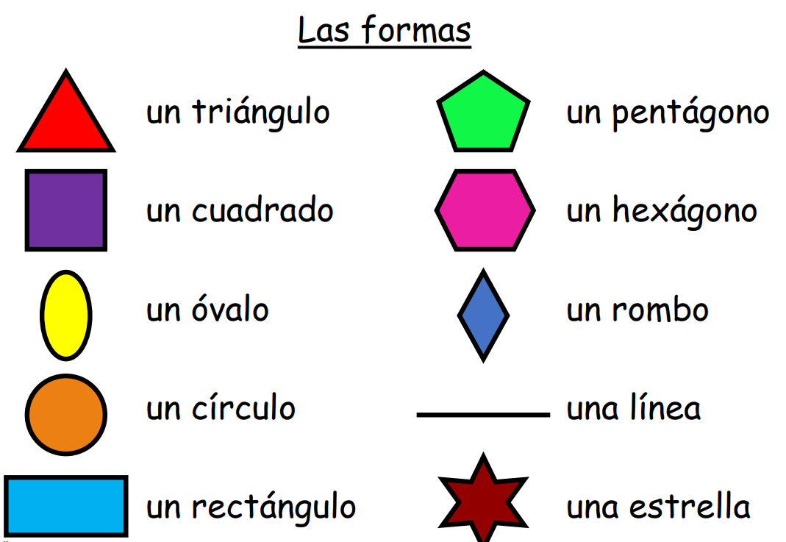
MFL knowledge organiser Y4 Autumn 1: Shapes
Key knowledge
Name at least 3 shapes in Spanish with accurate pronunciation.
Name at least 3 shapes in Spanish with the correct article.
Spell at least 3 shapes in Spanish with accurate spelling.
Count from 1 to 5.
Key vocabulary | Key vocabulary | Key vocabulary
un pentágono - a pentagon una línea - a line hexágonos – hexagons una estrella - a star pentágonos - pentagons Dibujad... Draw… rombos – rhombuses estrellas - stars líneas - lines | triángulos - triangles un triángulo - a triangle un cuadrado - a square un óvalo - an oval un círculo - a circle círculos - circles un rectángulo - a rectangle | cuadrados - squares un hexágono - a hexagon rectángulos - rectangles un rombo - a rhombus óvalos – ovals 1 – uno - one 2 – dos - two 3 - tres – three 4 – cuatro – four 5 – cinco - five
Prior knowledge | Colours
 | Numbers

Slide 8
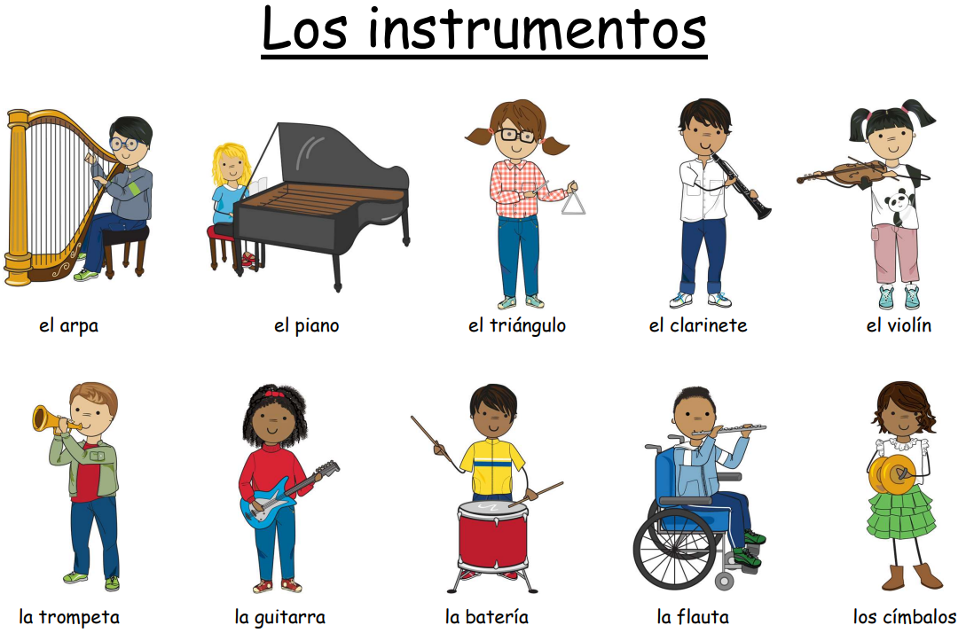
MFL knowledge organiser Y4 Autumn 2: Musical instruments
Key knowledge
Name at least five instruments correctly.
Match all the words for the instruments to their appropriate picture.
Attempt to spell at least three instruments.
Say what instrument I play .
Key vocabulary | Key vocabulary
el - the (masculine singular) el clarinete the clarinet la the (feminine singular) el arpa the harp los the (masculine plural) el piano the piano las the (feminine plural - not seen in this unit) | el triángulo the triangle la trompeta the trumpet el violín the violin la batería the drums los címbalos the cymbals la guitarra the guitar Toco… I play… la flauta the flute
Prior knowledge | El / la = the
 | Know what a noun is (in English)
 | Know what a verb is (in English)

Slide 9
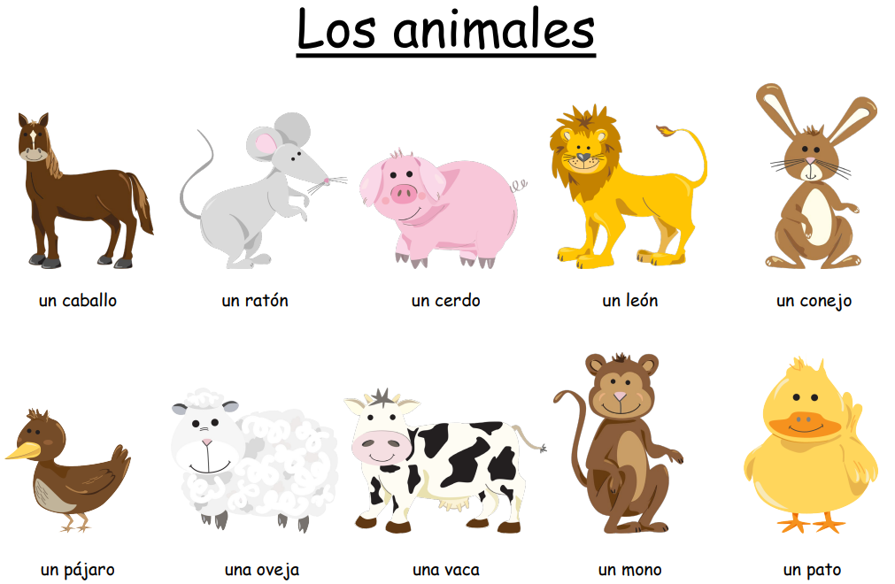
MFL knowledge organiser Y4 Spring 1: Animals
Key knowledge
Name at least five animals correctly.
Match animals in Spanish to the correct picture.
Attempt to spell at least three animals correctly in Spanish
Key vocabulary | Key vocabulary
los animales the animals un mono a monkey un a (masculine) un pato a duck una a (feminine) un ratón a mouse un caballo a horse | un conejo a rabbit un cerdo a pig una oveja a sheep un león a lion una vaca a cow un pájaro a bird Soy... I am …
Prior knowledge | Un / una = a
 | Know what a noun is (in English)
 | Know what a verb is (in English)

Slide 10
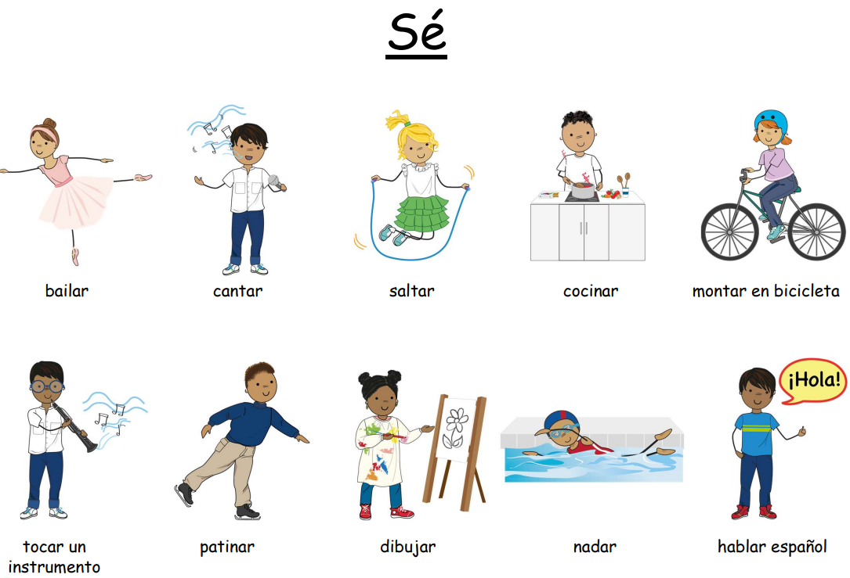
MFL knowledge organiser Y4 Spring 2: I know how…
Key knowledge
Recognise, remember and spell 10 action verbs in Spanish.
Use these verbs in the infinitive to form positive and negative sentence structures with ‘sé’ (I know how) and ‘no sé’ (I do not know how).
Attempt to combine positive and negative sentence structures to form longer and more complex sentences using the conjunctions ‘y’ (and) & ‘pero’ (but).
Key vocabulary | Key vocabulary
Sé... I know how... tocar un instrumento to play an instrument No sé... I do not know how... patinar to ice-skate bailar to dance dibujar to draw | cantar to sing nadar to swim saltar to jump hablar español to speak Spanish cocinar to cook y and montar en bicicleta to ride a bike pero but
Prior knowledge | Know what a verb is (in English)

Slide 11
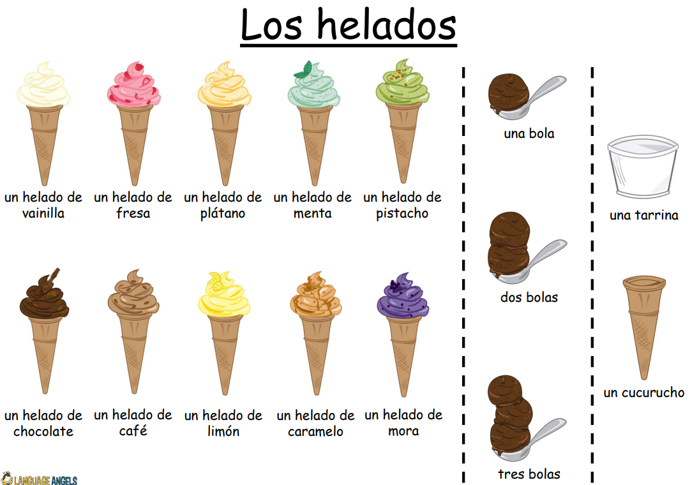
MFL knowledge organiser Y4 Summer 1: Ice cream
Key knowledge
Recognise, remember and spell 10 action verbs in Spanish.
Use these verbs in the infinitive to form positive and negative sentence structures with ‘sé’ (I know how) and ‘no sé’ (I do not know how).
Attempt to combine positive and negative sentence structures to form longer and more complex sentences using the conjunctions ‘y’ (and) & ‘pero’ (but).
Key vocabulary | Key vocabulary
un helado an ice-cream un cucurucho a cone …de vainilla vanilla flavour una tarrina a small tub/pot …de fresa strawberry flavour una bola one scoop …de plátano banana flavour dos bolas two scoops | ¡Hola! Hello! …de café coffee flavour ¿Qué sabor? Which flavour? …de limón lemon flavour ¿Cuántas bolas? How many scoops? …de caramelo caramel flavour ¿Cuánto cuesta? How much? | …de menta mint flavour tres bolas three scoops …de pistacho pistachio flavour por favor please …de chocolate chocolate flavour …de mora blackberry flavour gracias thank you Quisiera... I would like... ¡Adiós! Goodbye! y and
Prior knowledge | Fruit
 | Numbers
 | Un / una = a

Slide 12
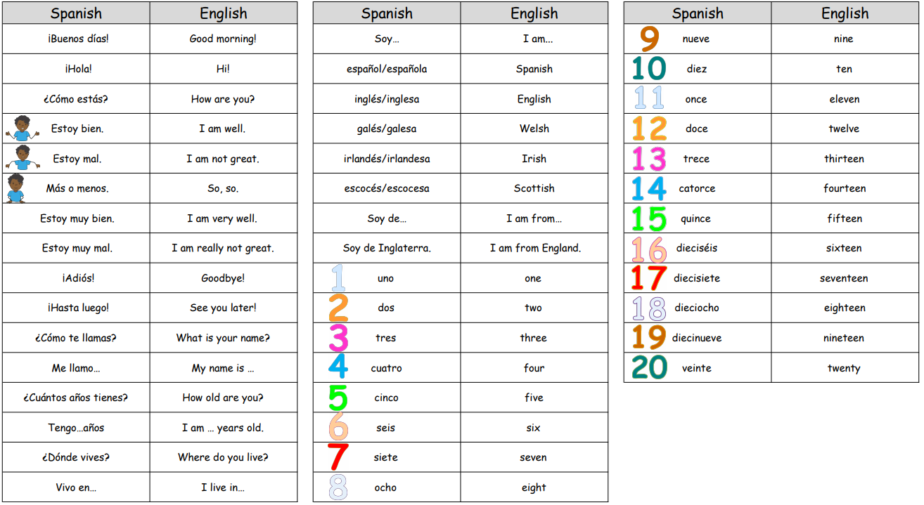
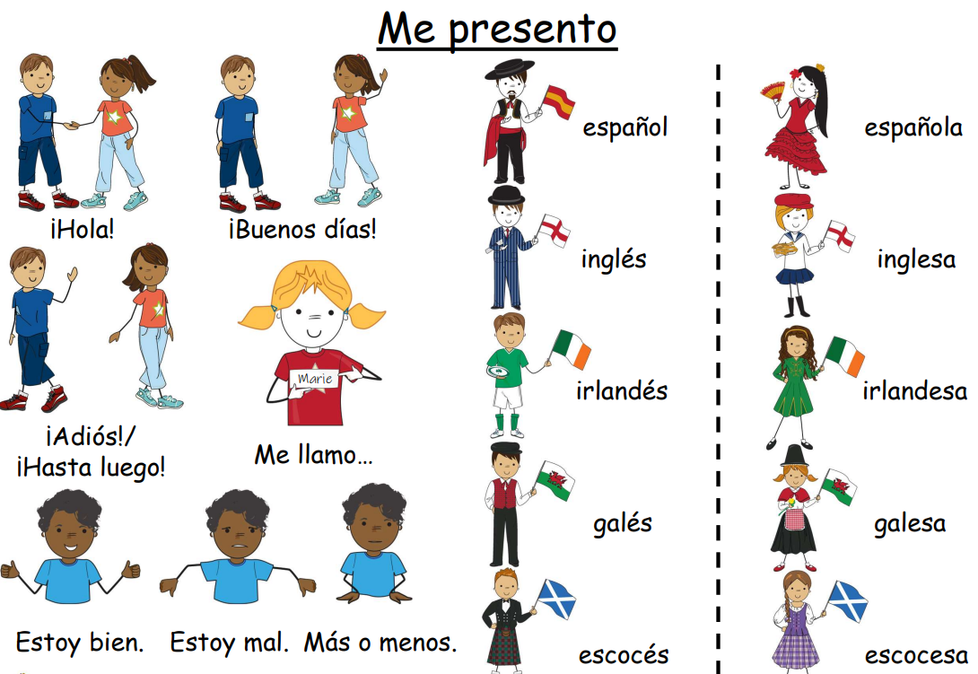
MFL knowledge organiser Y4 Summer 2: Presenting myself
Key knowledge
Know how count to 20 in Spanish.
Ask somebody how they are feeling and give an appropriate response back.
Ask somebody their age, name, where they live and reply.
Key vocabulary |  | Key vocabulary
Prior knowledge | Numbers and colours unit
 | I am learning Spanish unit

Slide 13
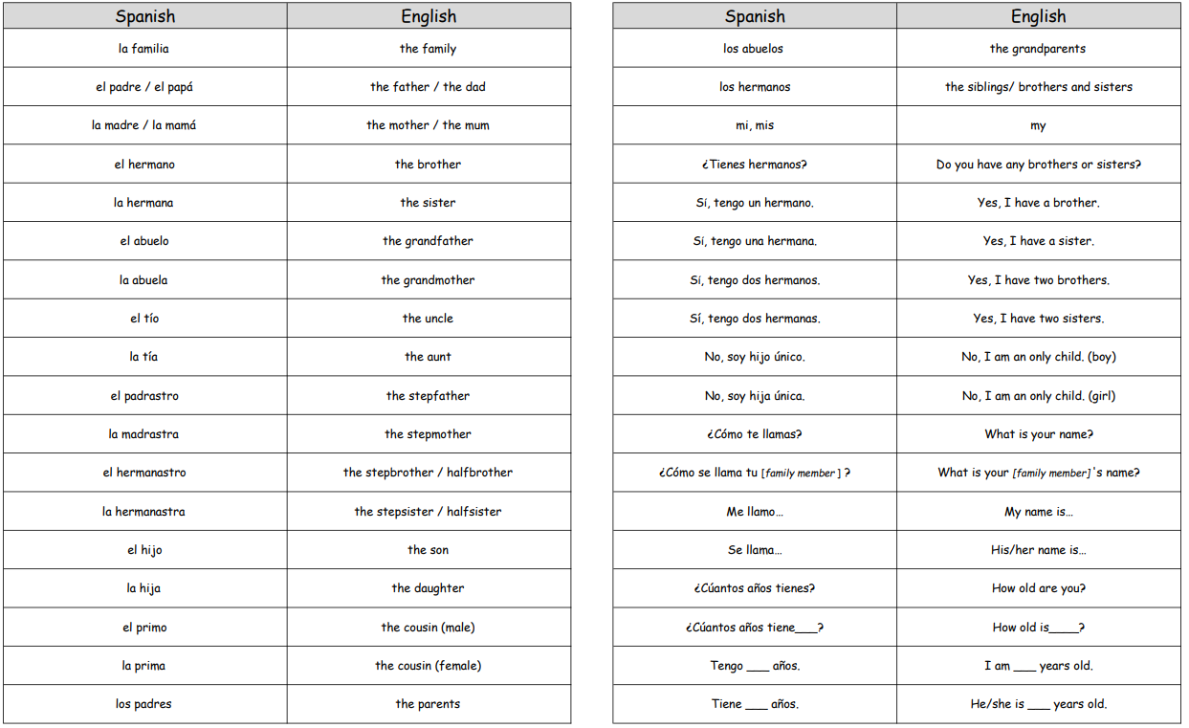
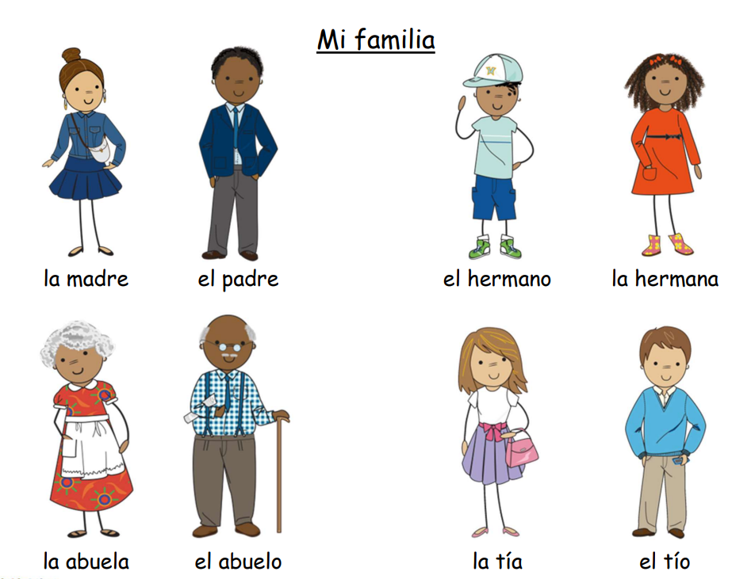
MFL knowledge organiser Y5 Autumn 1: Family
Key knowledge
Remember the nouns for family members in Spanish from memory.
Describe our own or a fictitious family in Spanish by name, age and relationship.
Count up to 100 in Spanish.
Understand possessive adjectives better in Spanish (‘my’ form only)
Key vocabulary |  | Key vocabulary
Prior knowledge | Presenting myself unit (how to say your name, age, where you live and nationality and numbers 1-20).
 | What a verb is in English

Slide 14
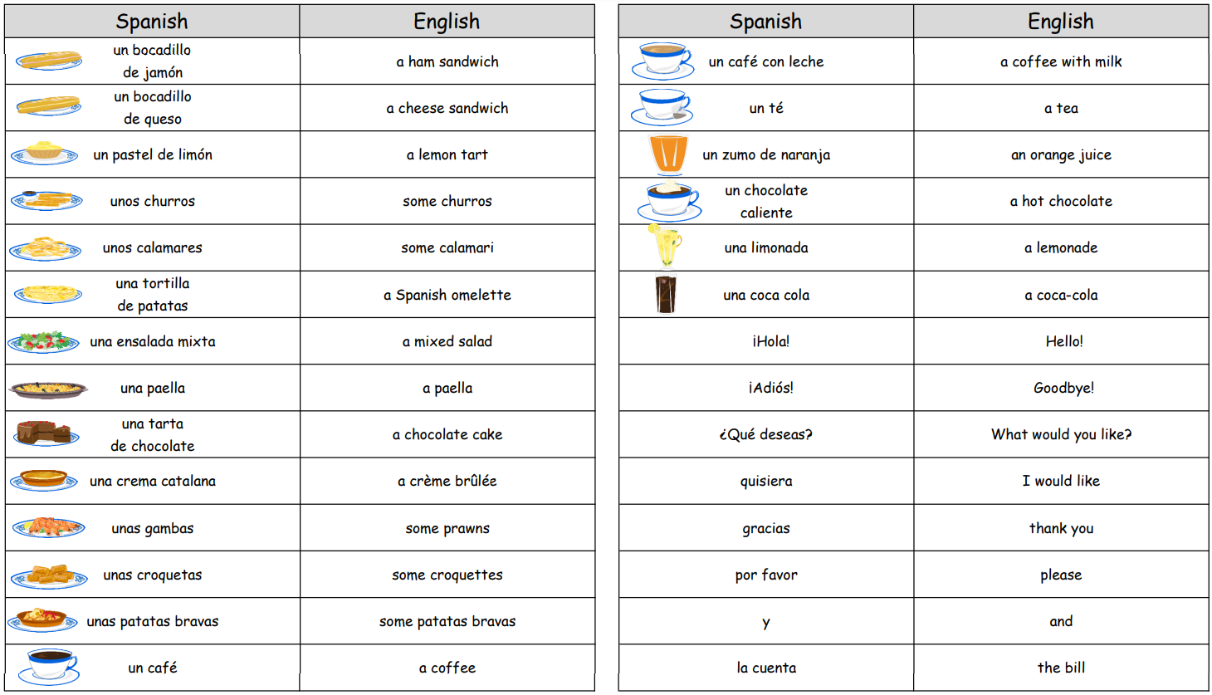
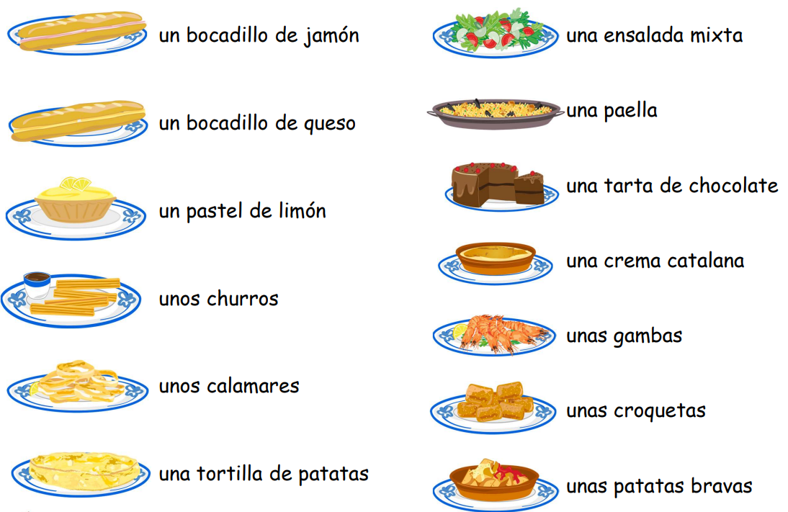
MFL knowledge organiser Y5 Autumn 2: At the cafe
Key knowledge
Say 10 different foods, snacks and drinks
Say another 10 different foods, snacks and drinks
Use some key phrases to help me perform role-play in the Spanish cafetería.
Calculate the bill in Spanish and learn more about the Spanish currency.
Key vocabulary |  | Key vocabulary
Prior knowledge | Vocabulary from the Early Learning units and the Intermediate unit 'Presenting Myself'.
 | • What a noun and article/determiner is in English.
 | • What making a noun 'plural' means. • How to say ‘hello’, ’goodbye’, ‘please’ and ‘thank you’ in Spanish

Slide 15
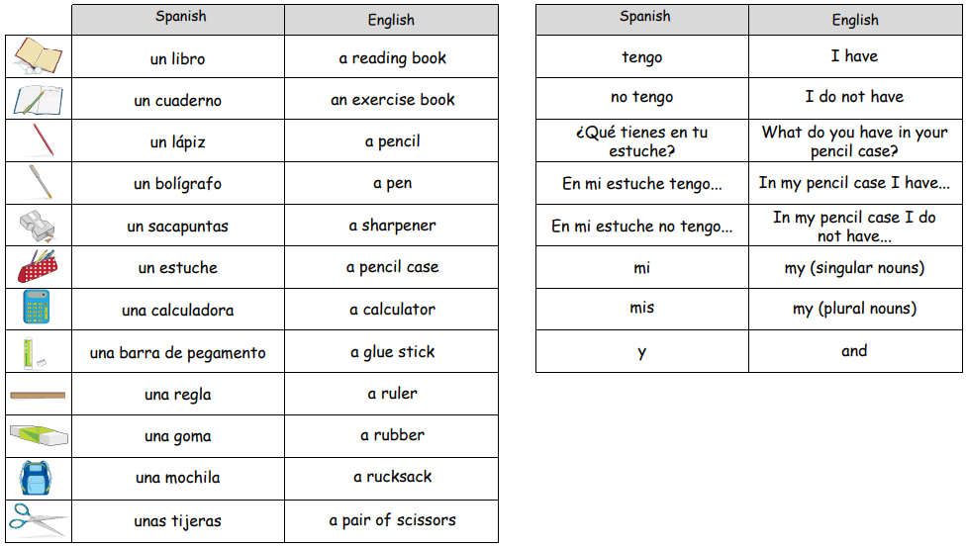
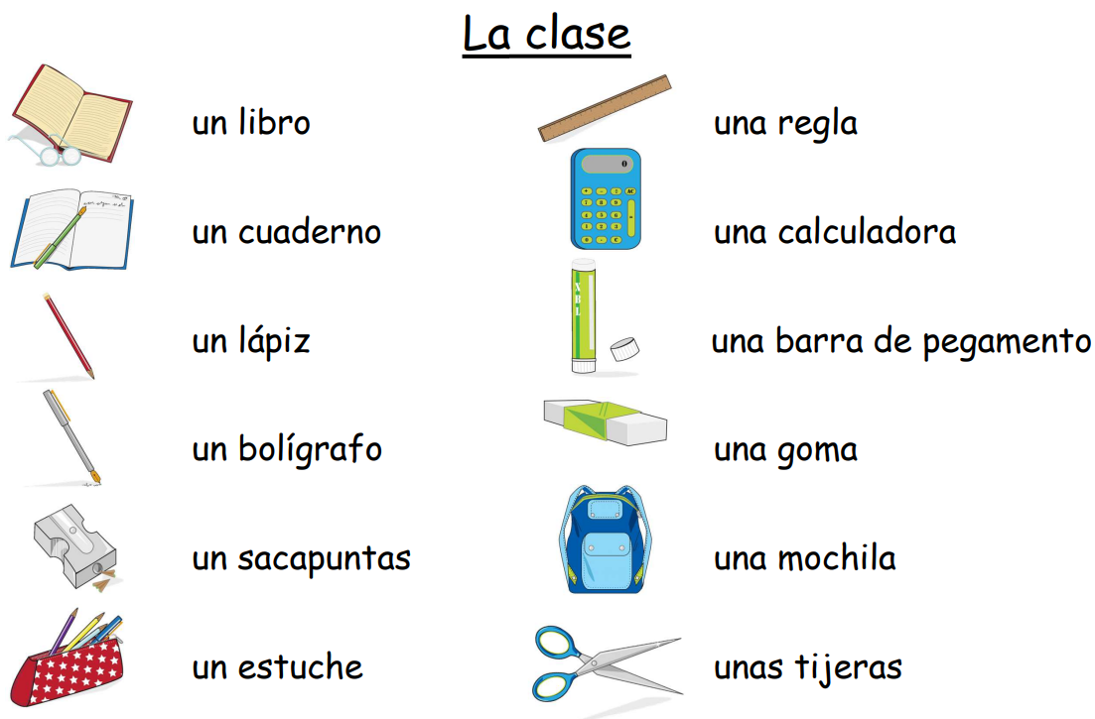
MFL knowledge organiser Y5 Spring 1: The Classroom
Key knowledge
Recall from memory a selection of nouns and indefinite articles for common classroom objects.
Learn how to use the negative in Spanish.
Describe what we have and do not have in our pencil case.
Respond to simple classroom commands.
Key vocabulary |  | Key vocabulary
Prior knowledge | Vocabulary from I am learning Spanish Unit
 | Vocabulary from Presenting Myself Unit

Slide 16
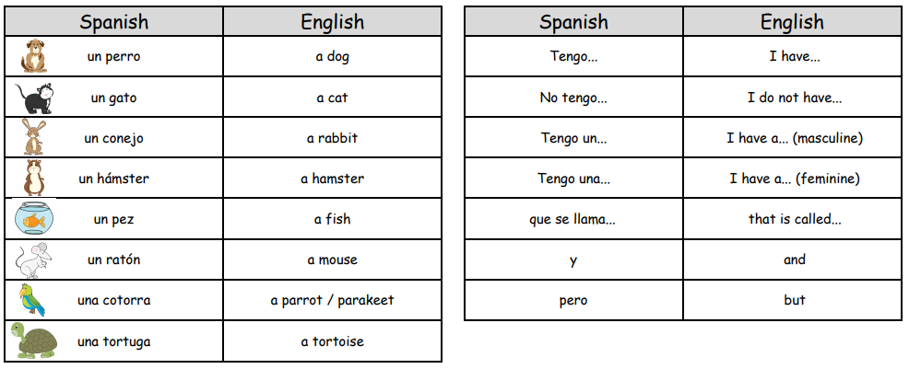
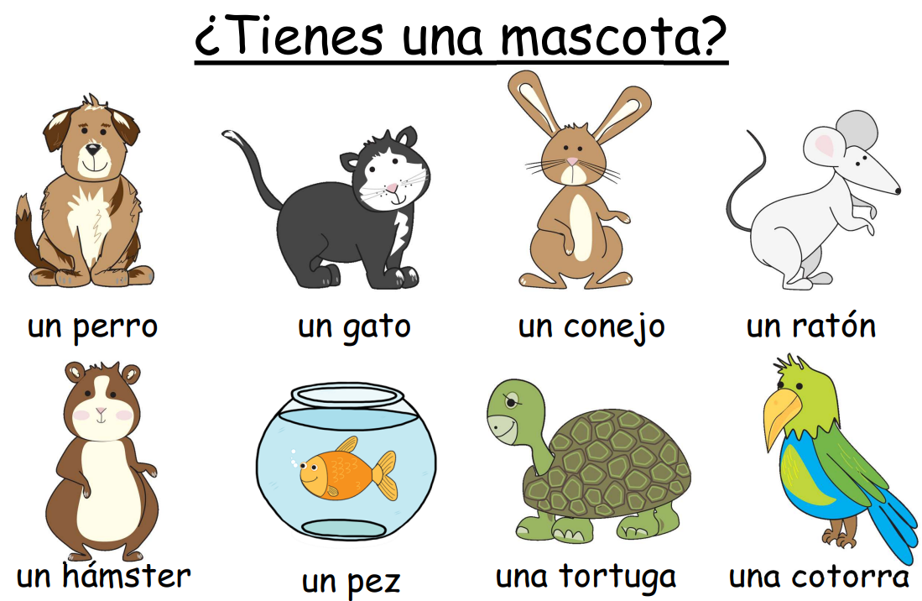
MFL knowledge organiser Y5 Spring 2: Do you have a pet?
Key knowledge
Know the nouns and indefinite articles for 8 common pets.
Ask somebody if they have a pet and give an answer back.
Say in Spanish what pet we have/do not have and give our pet’s name.
Start to use the simple conjunctions 'y' (and) and 'pero' (but)
Key vocabulary |  | Key vocabulary
Prior knowledge | Vocabulary from My Family Unit
 | Vocabulary from Presenting Myself Unit

Slide 17
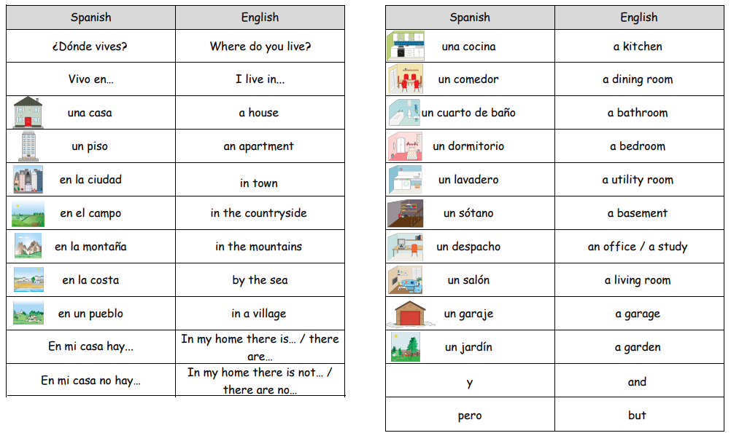
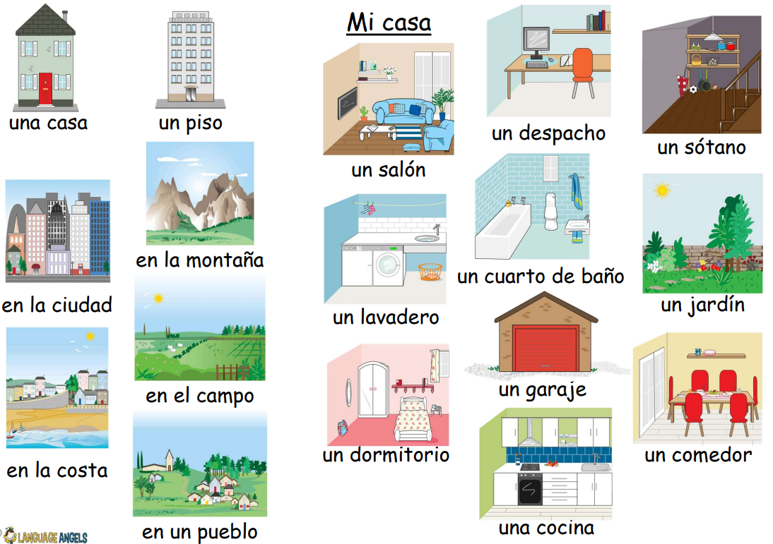
MFL knowledge organiser Y5 Summer 1: My Home
Key knowledge
Say and write in Spanish whether we live in a house or an apartment.
Say what room we have and do not have at home using the key structure en mi casa hay… and en mi casa no hay…
Use the conjunction y to link two sentences together.
Key vocabulary |  | Key vocabulary
Prior knowledge | Vocabulary from My Family Unit
 | Vocabulary from Presenting Myself Unit
 | Vocabulary from Do You Have A Pet Unit

Slide 18
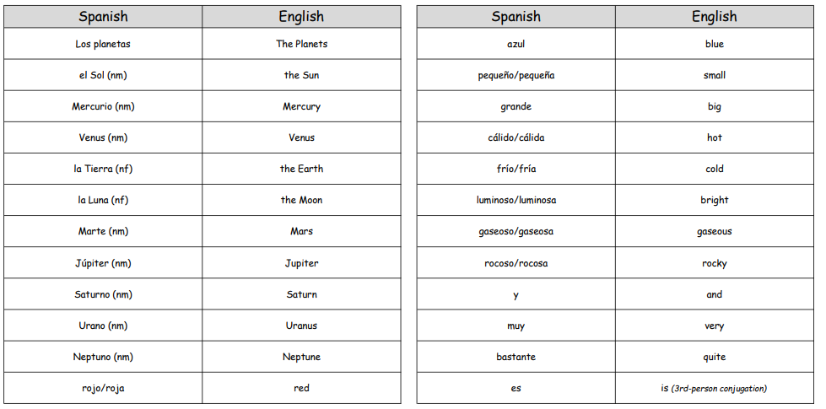
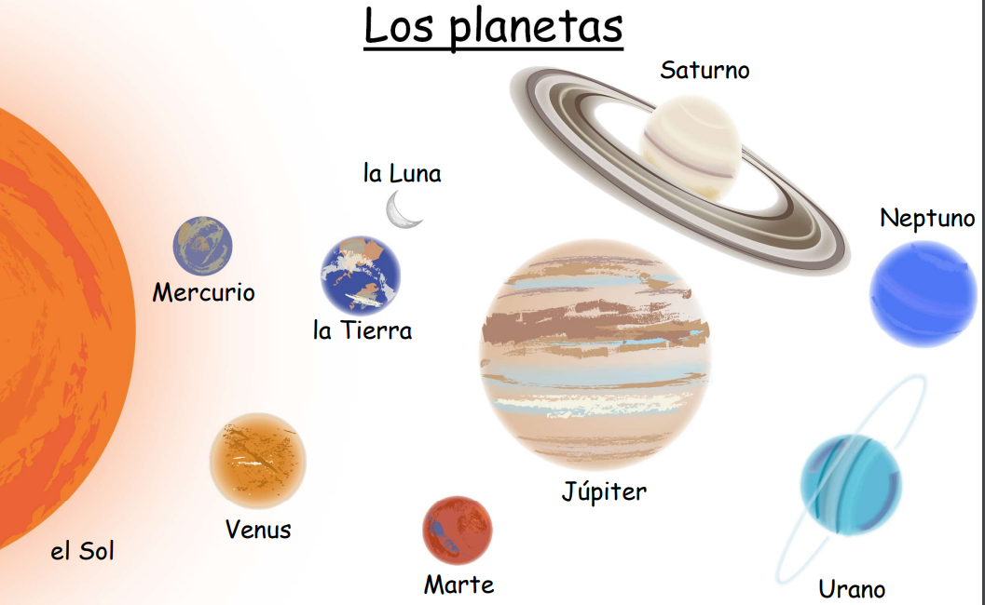
MFL knowledge organiser Y5 Summer 2: Planets
Key knowledge
Name and label a map of the Solar System in Spanish. Apply the rules of adjectival agreement to describe the Solar System in Spanish. Use conjunctions and intensifiers to extend descriptions of the Solar System. Ask key questions in Spanish in order to conduct an interview with an astronaut. Answer the questions in Spanish in order to present themselves as an astronaut.
Key vocabulary |  | Key vocabulary
Prior knowledge | Vocabulary of colours
 | Vocabulary from Presenting Myself Unit
 | What an adjective is in English

Slide 19
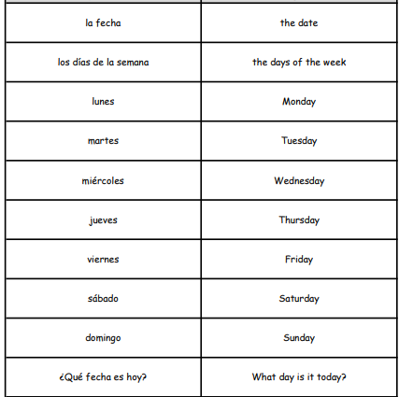
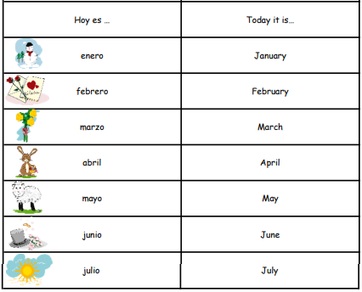
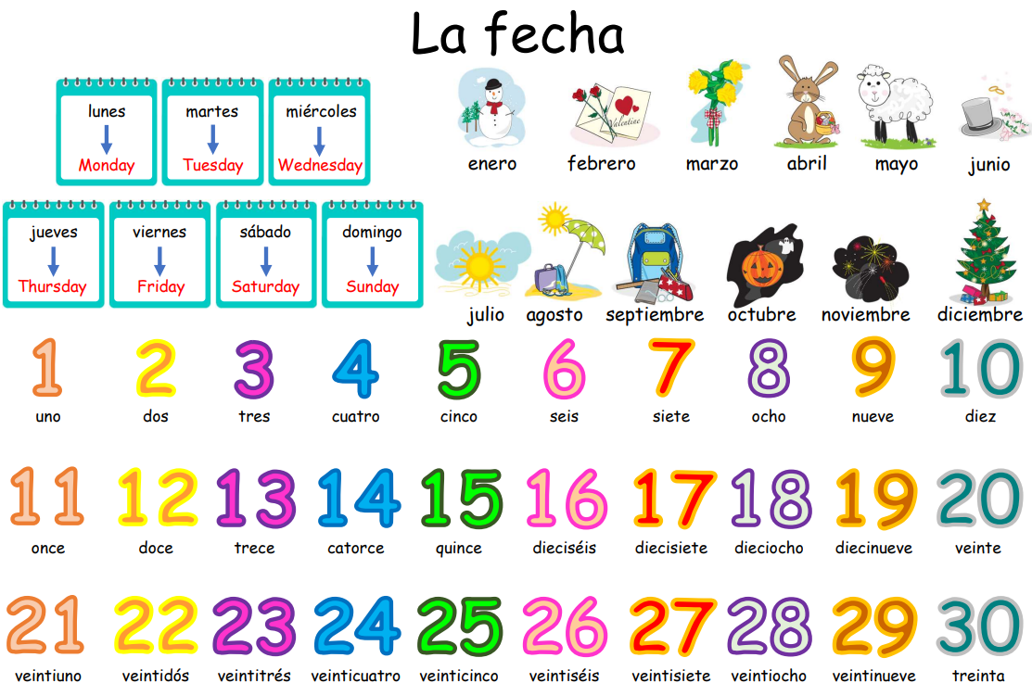
MFL knowledge organiser Y6 Autumn 1: What is the date?
Key knowledge
Recognise and recall the 12 months of the year in Spanish. Ask what the date is and say the date in Spanish. Ask somebody when their birthday is and say when their own birthday is in Spanish.
Key vocabulary |  | Key vocabulary
Prior knowledge | Vocabulary of numbers to 20
 | Vocabulary from My Family Unit
 | What an adjective is in English

Slide 20
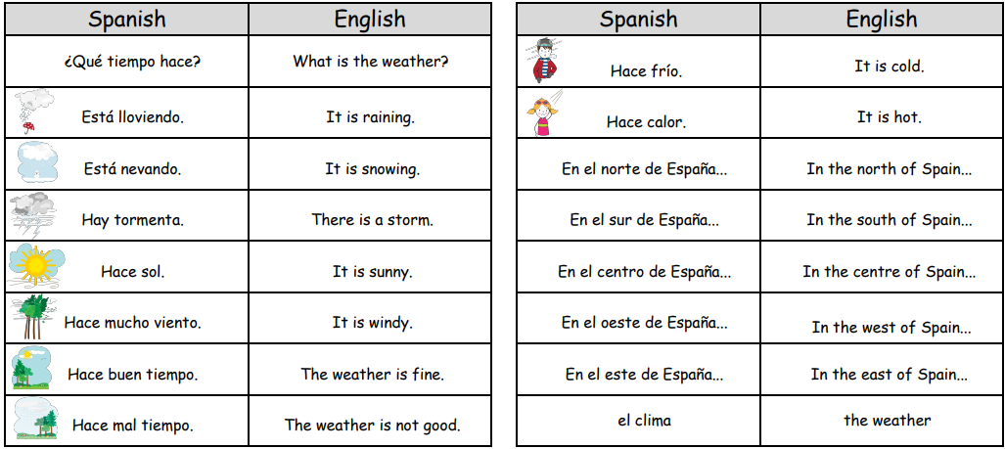
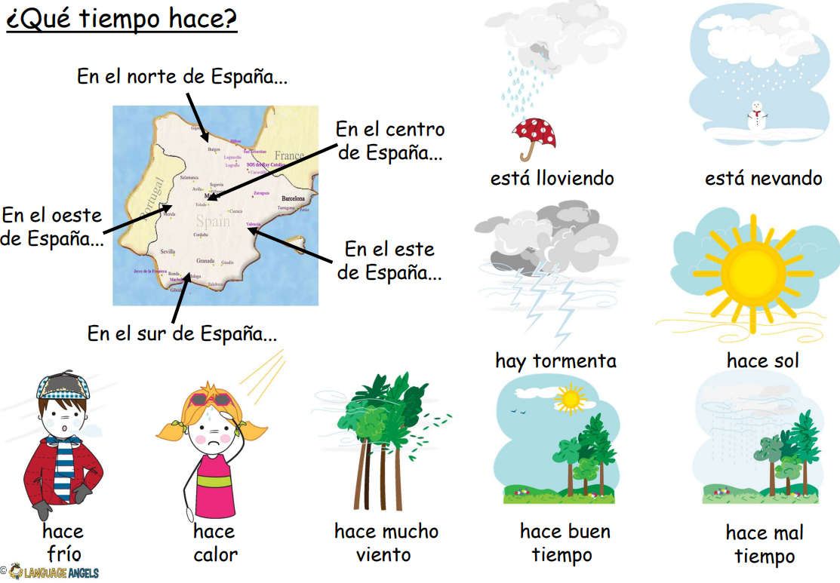
MFL knowledge organiser Y6 Autumn 2: The weather
Key knowledge
Recognise and recall the 9 weather expressions in Spanish from memory. Ask what the weather is today and give a reply in Spanish. Describe the weather in Spain, in Spanish using a weather map with symbols
Key vocabulary |  | Key vocabulary
Prior knowledge | Months vocabulary
 | Knowing how to introduce self

Slide 21
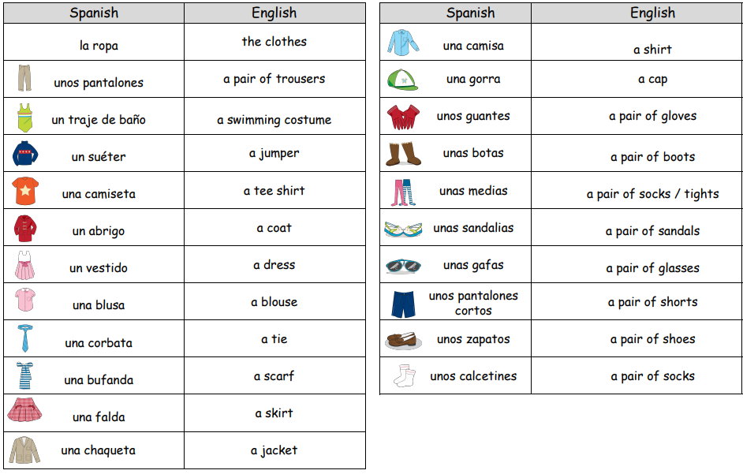
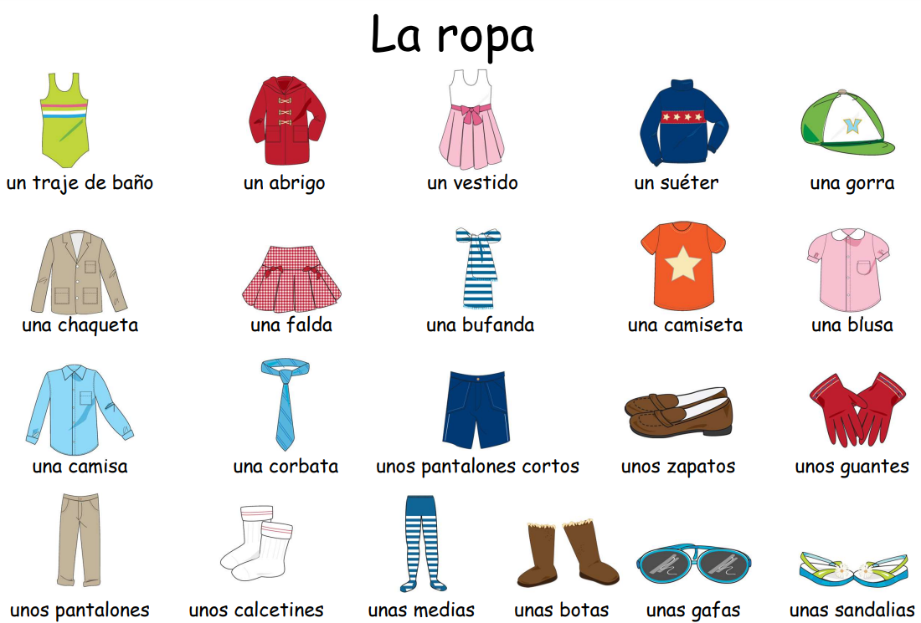
MFL knowledge organiser Y6 Spring 1: Clothes
Key knowledge
Recognise and recall from memory 21 items of clothing. Describe what you and possibly somebody else is wearing. Revisit the use of the possessive adjective ‘my’ in Spanish and describe clothes in terms of colour.
Key vocabulary |  | Key vocabulary
Prior knowledge | Months vocabulary
 | Knowing how to introduce self
 | Colours

Slide 22
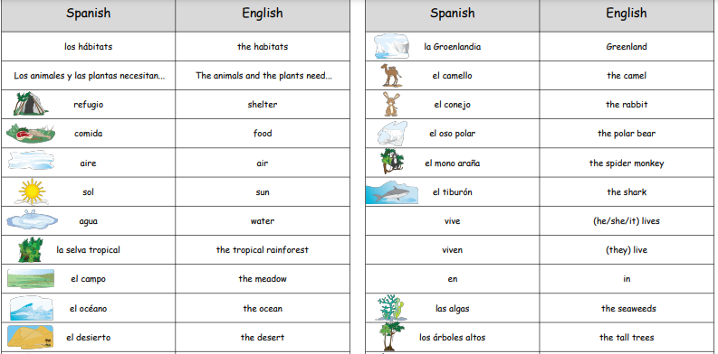
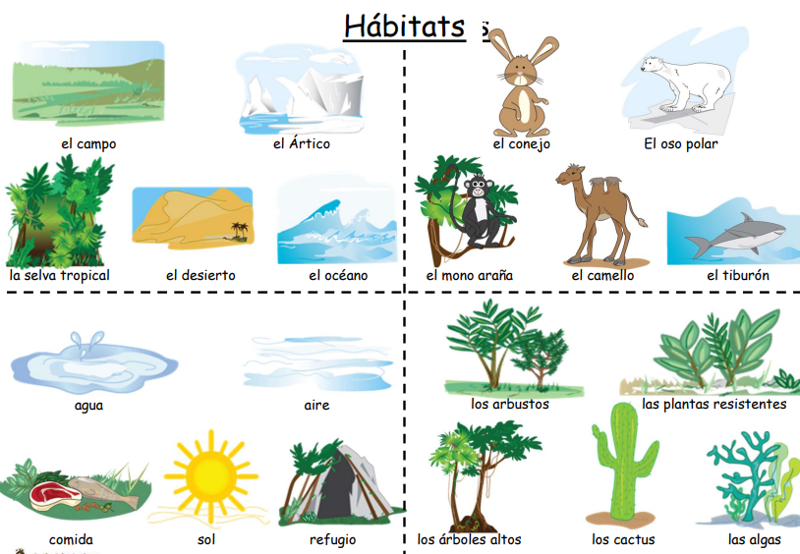
MFL knowledge organiser Y6 Spring 2: Habitats
Key knowledge
Say and write the key elements that animals and plants need to survive. Name the 5 most common types of habitats. Name an animal and a plant that live and grow in each type of habitat
Key vocabulary |  | Key vocabulary
Prior knowledge | Habitats knowledge in Geography and Science

Slide 23
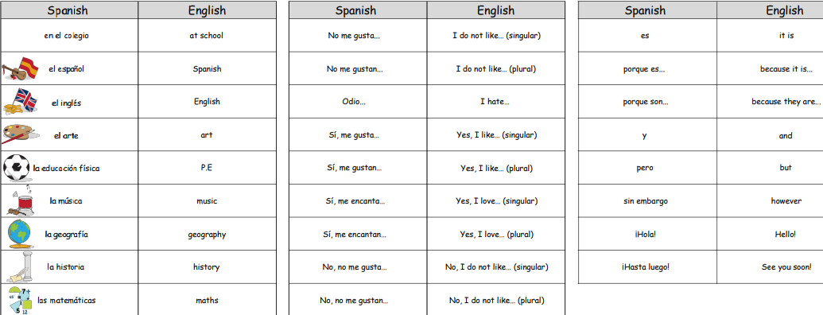
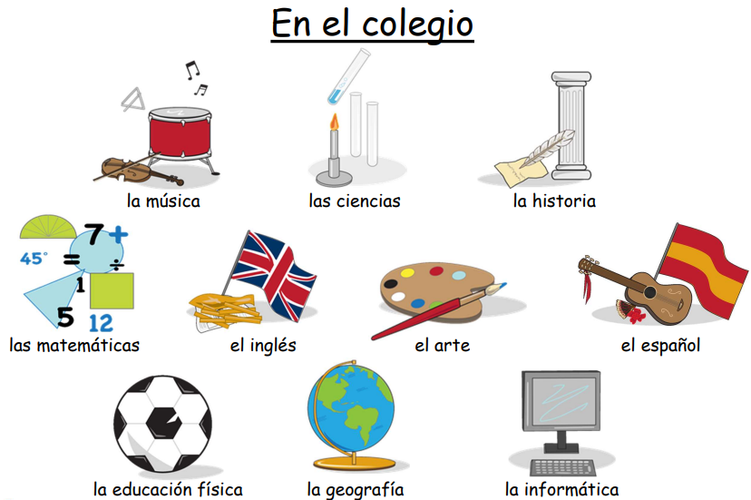
MFL knowledge organiser Y6 Summer 1: At School
Key knowledge
Name the subjects we study in school in Spanish. Extend sentences by giving an opinion on the various school subjects. Start to tell the time by learning how to say time by the hour. Explore the irregular, high frequency verb 'ir' (to go) in full.
Key vocabulary |  | Key vocabulary
Prior knowledge | Vocabulary from The Classroom Unit
 | Numbers

Slide 24
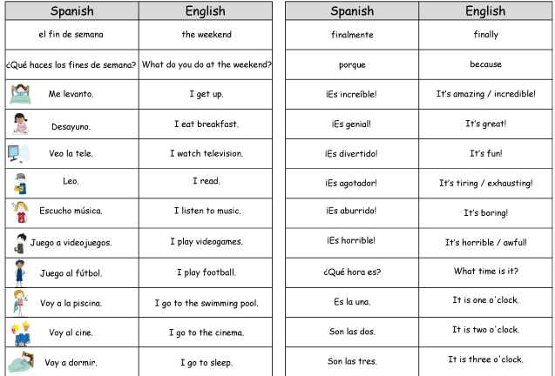
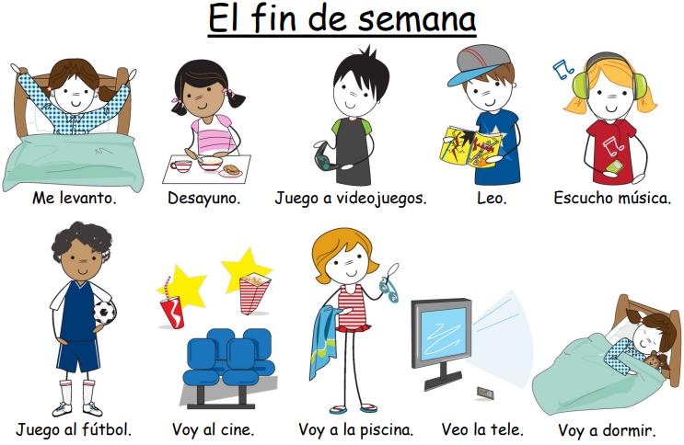
MFL knowledge organiser Y6 Summer 2: The Weekend
Key knowledge
Tell the time in Spanish using quarter past, half past and quarter to. Say and write in Spanish what we do at the weekend using two or more sentences. Integrate conjunctions and opinions into written and spoken work to make more interesting and extended sentences.
Key vocabulary |  | Key vocabulary
Prior knowledge | Vocabulary from The Classroom Unit
 | Numbers
 | Time from School Unit

