Slide 1

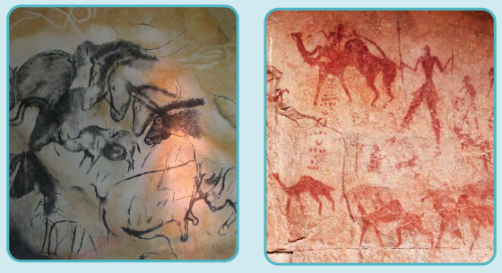
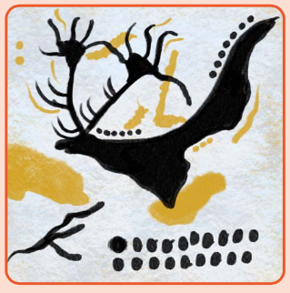
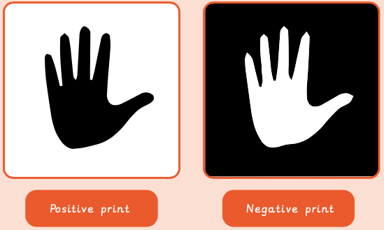
Art knowledge organiser Y3: painting and mixed media
Key knowledge
To know how to use line correctly when sketching
To use smudging with charcoal
To know what natural pigments can be used in art
To know how to create texture using different mediums
To understand what drawing mediums were used prehistorically
Key vocabulary | Meaning
drawing medium | Different materials used to draw e.g. pencils, charcoal, pastels
pigment | The colour in a natural object
Prehistoric | A time before humans wrote things down to record history
Proportion | How big a part of something looks compared to the rest of it
Scale up | Enlarge a drawing so the proportions stay the same
Smudging | Blending a soft drawing material on a surface
Prior knowledge | To know how to create different textures
 | To name and use a range of mediums
 | To know what a collage is

Slide 2
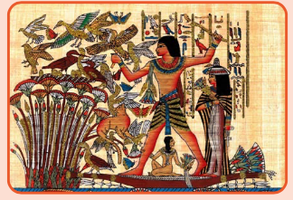
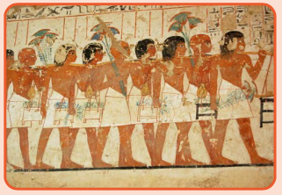
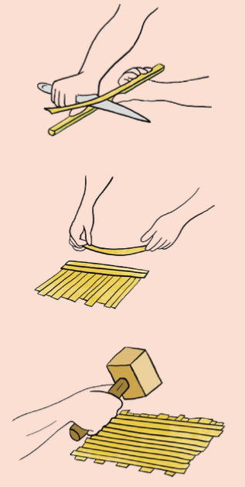
Art knowledge organiser Y3: craft and design
Key knowledge
To know how to create a colour wash
To use a range of mediums to create a textured background
To develop design ideas before creating final pieces
To understand a range of techniques used in historic times
To use a range of layouts to display imagery
Key vocabulary | Meaning
technique | Skills applied by an artist to produce a particular art form
pattern | A design in which shapes, colours or lines are repeated
Layout | The arrangement of different elements within a given space
Imagery | A collection of images from a range of art forms
Composition | Putting different elements together in a pleasing way
Colour | A feature of everything in the world that is seen through the way it reflects light
Prior knowledge | To know what texture is
 | To know how to create different hues of colours
 | To know how we can create art using different forms

Slide 3
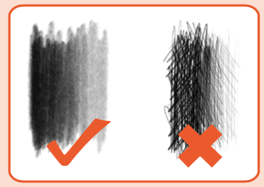
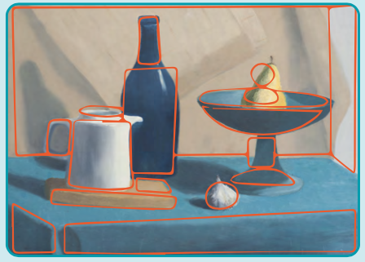
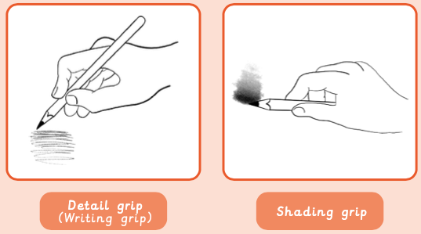
Art knowledge organiser Y3: drawing
Key knowledge
To know how artists use shape in drawing
To know how to create tone with shading
To know how to make a rubbing
To know how to add detail to an image using shading and shape
To scale and create a composition of art
Key vocabulary | Meaning
abstract | Art where the subject doesn’t look like it does in real life
geometric | A regular shape with angles and straight lines
organic | Irregular, natural shapes
shading | Shows areas of light and dark
tone | The light and dark in an object
texture | A surface that is not flat
Prior knowledge | To name some sketching methods such as stippling/cross hatching
 | To know what an illustration is
 | To know how to use charcoal

