Slide 1
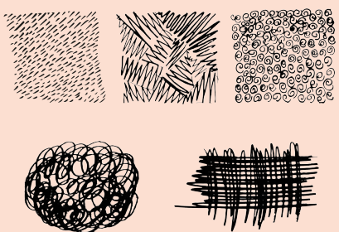
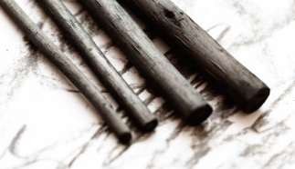
Art knowledge organiser Y2: drawing
Key knowledge
To know how to use charcoal effectively
To know what stippling is
To know how to cross hatch
To know what an illustrator is
To know how to show expression
Key vocabulary | Meaning
charcoal | A drawing material made from burnt wood
cross-hatching | Drawing lines crossed over and close together
expression | The look on a face caused by how someone is feeling
stippling | Making quick up and down hand movements to make dots and dashes
illustrations | Showing a story using pictures
illustrator | Someone who draws illustrations
Prior knowledge | To know what line is
 | To know what texture is
 | To know some different ways to make marks

Slide 2
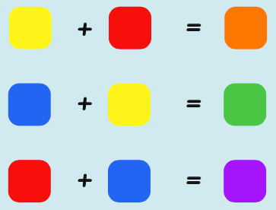
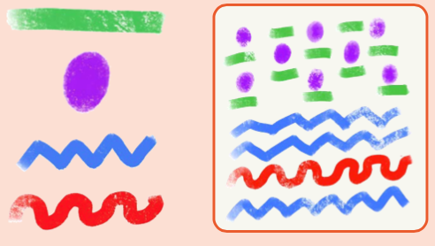
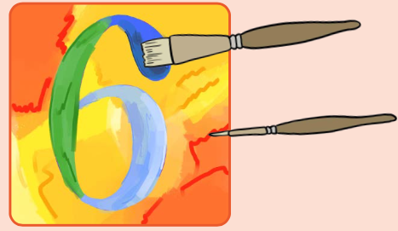
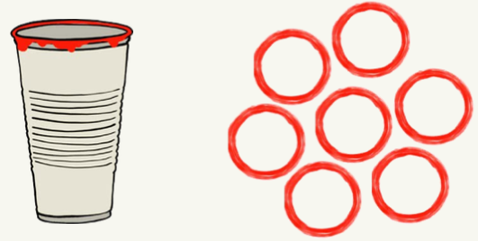
Art knowledge organiser Y2: painting and mixed media
Key knowledge
To know how different surfaces create different textures
To know what a collage is
To know how we can create different textures using nature
To use a range of mediums
Key vocabulary | Meaning
collage | Sticking different materials onto a background to create art
texture | A surface that is not flat
Romare Bearden | An artist who used textures and collages
Medium | Material used to create art
Prior knowledge | To know what the three primary colours are
 | To know what the three secondary colours are and how to make them
 | To know what a hue is

Slide 3
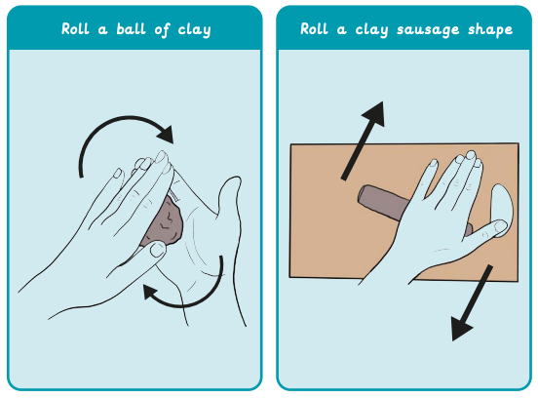
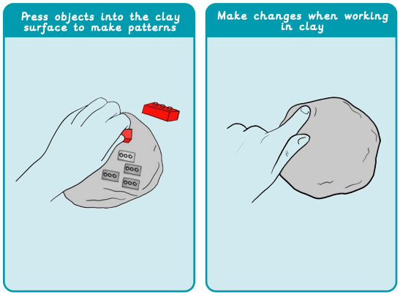
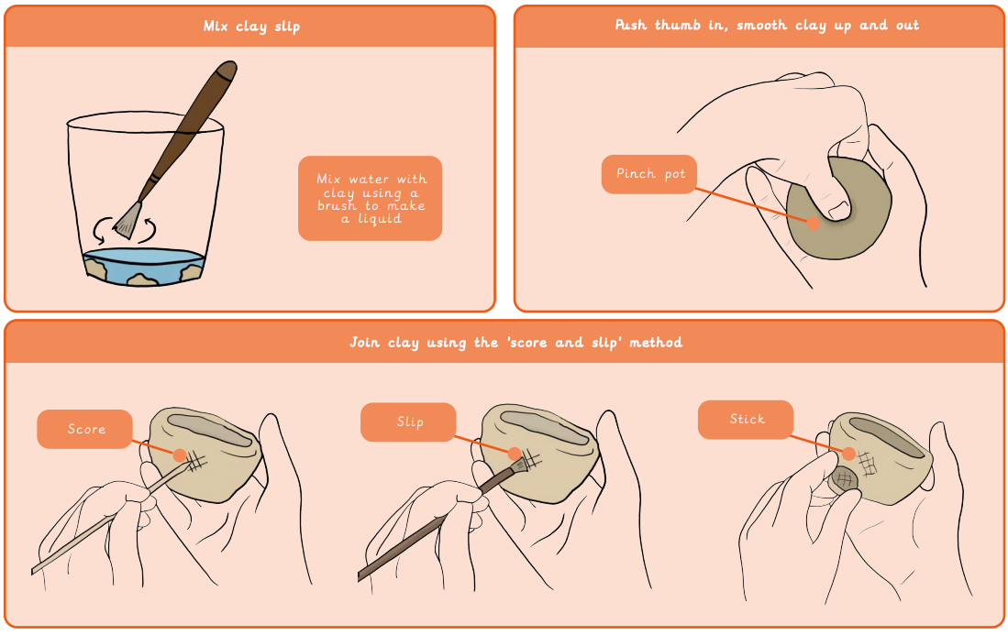
Art knowledge organiser Y2: sculpture and 3D- clay
Key knowledge
To know how to shape clay by hand
To know how to join pieces of clay together
To know how to use tools to score
To explore what objects make good impressions
To create a clay tile using a design
Key vocabulary | Meaning
clay slip | A runny mixture of clay and water, a bit like ‘clay glue’
impress | Pushing objects into a clay surface to make interesting marks
relief | 3D parts of an artwork that are joined to a flat base
score | Marking hatched lines into the clay surface
surface | The top layer of something
Prior knowledge | To know what a sculpture is
 | To know what 3D means
 | To know what adding detail implies to artwork

