Slide 1
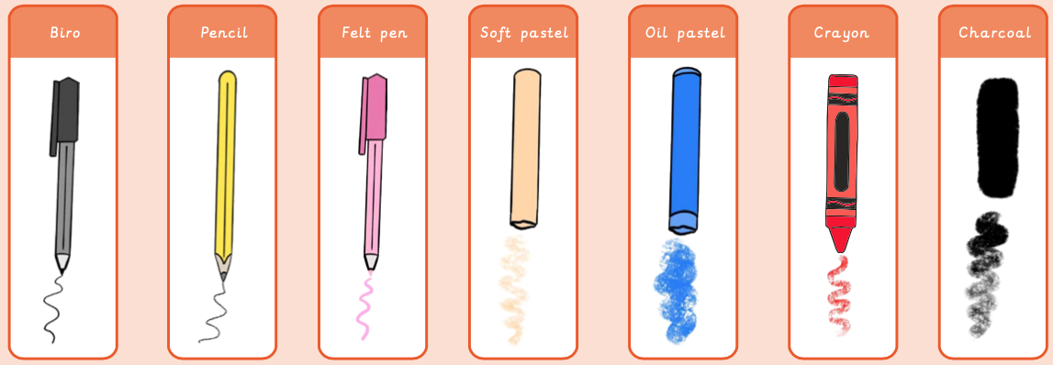
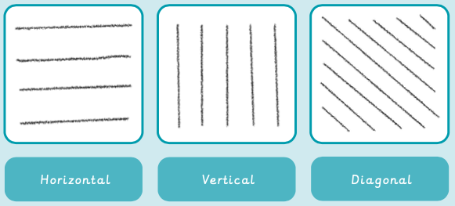
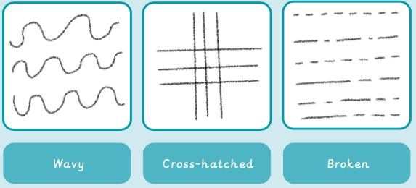
Art knowledge organiser Y1: drawing
Key knowledge
To know what a line is
To know what different mediums can create line
To know that texture tells us what something feels like
To know how to make marks
To know how observing shapes are important when drawing
Key vocabulary | Meaning
line | A mark which can be different lengths, widths and create shapes
Mark-making | Creating lines, patterns and shapes
observation | To look at something carefully
texture | A surface that is not flat
horizontal | Flat or level with the ground
vertical | Pointing straight up
Prior knowledge | To know how to hold a pencil correctly
 | Children have explored drawing

Slide 2
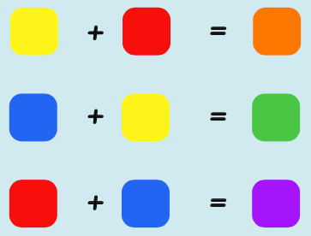
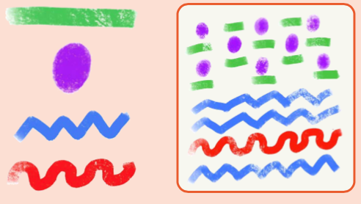
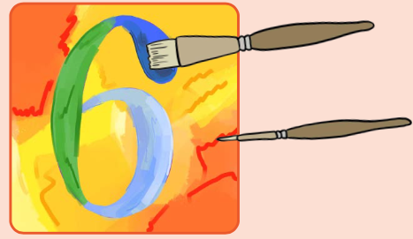
Art knowledge organiser Y1: painting and mixed media
Key knowledge
To know what the three primary colours are
To know what the three secondary colours are
To know how to create the secondary colours
To know how to explore mixing to create different hues
To know how to make a print
Key vocabulary | Meaning
hue | Describing an exact colour: sky blue, dark green, rose pink
mix | Combining two or more colours together
pattern | A design were shapes, colours or lines are repeated
primary colours | Red, yellow and blue
secondary colours | Orange, green and purple
print | Transferring an image onto another surface eg. Finger painting
Prior knowledge | Children have explored some colour mixing with paint
 | Children have explored using a range of tools

Slide 3
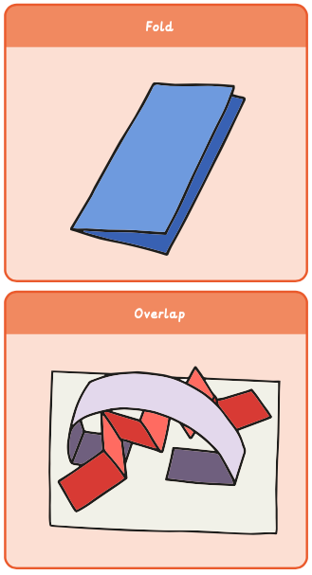
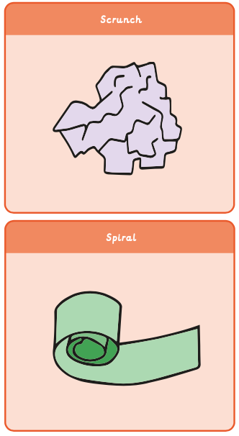
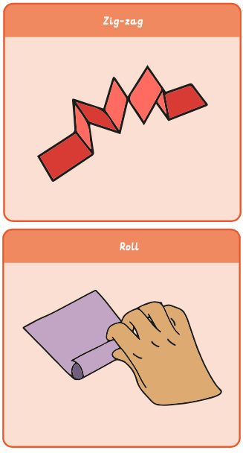
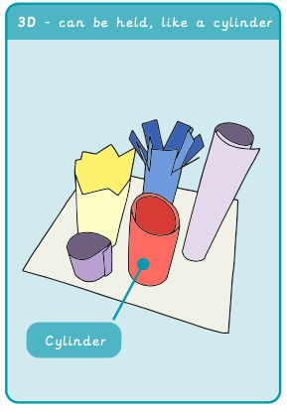
Art knowledge organiser Y1: sculpture and 3D
Key knowledge
To know how to shape paper by rolling
To explain what a sculpture is
To know the difference between 2D and 3D art
To know how to make a concertina fold
To name a piece of 3D artwork
Key vocabulary | Meaning
cylinder | A tube shape
detail | Extra decoration or items to add interest
sculpture | Art in three dimensions; walk around it to look at it
2D | A flat shape
3D | A solid shape; art that isn’t flat
Prior knowledge | Children have used junk modelling in EYFS
 | Children have explored using and observing different textures

