Slide 1
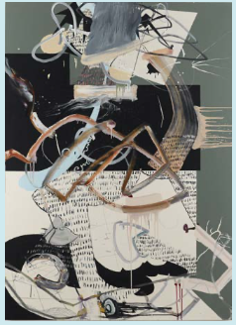
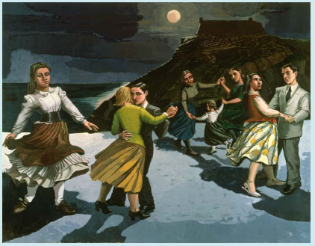
Art knowledge organiser Y6: painting and mixed media
Key knowledge
To develop analytical skills of a painting
To find meaning within artwork
To interpret artwork
To understand how artwork can portray a story
To develop independent research skills
Key vocabulary | Meaning
abstract | Art that doesn’t look like it does in real life
analyse | To investigate something in detail
interpret | To undestand the meaning of something
evaluate | To form an opinion about how good or useful something is
tableau | People recreating a scene from a story, painting in a motionless pose
Prior knowledge | To combine materials for effect
 | To know how to use mixed media
 | To identify features of a self-portrait

Slide 2
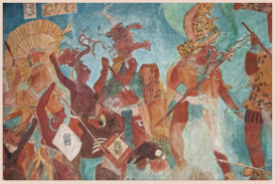
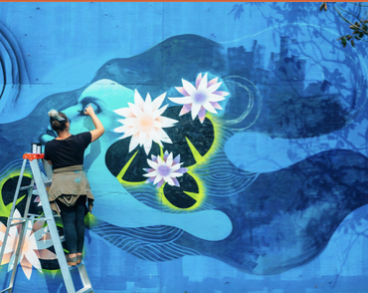
Art knowledge organiser Y6: drawing
Key knowledge
To explore experimental, expressive mark making
To understand how symbolism can convey meanings
To explore the chiaroscuro technique
To evaluate the intention of street art
To know how to create a powerful image
Key vocabulary | Meaning
aesthetic | Describes something that is pleasing to look at
commissioned | When someone is asked to create a piece of art
interpretation | How the meaning of an image is understood
mural | A painting made directly onto a wall
symbolic | Conveying a message using symbols
tone | How light or dark something is
Prior knowledge | To explore drawing with prints
 | To understand the purpose of imagery
 | To know what collography is

Slide 3
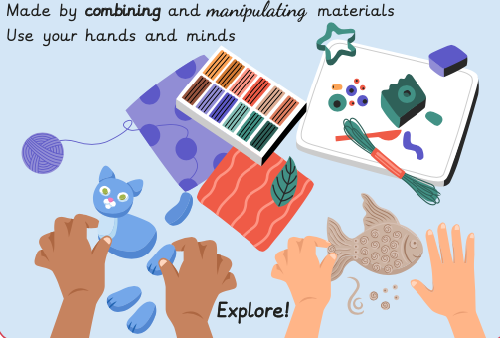
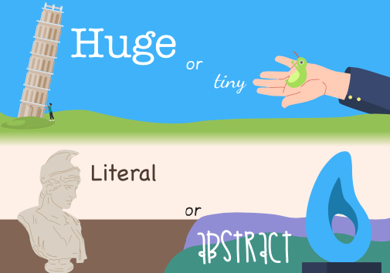
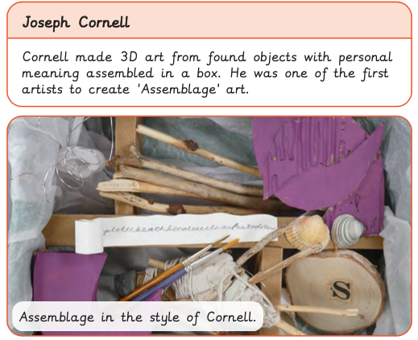
Art knowledge organiser Y6: Sculpture and 3D
Key knowledge
To explore the concept of self and use key memories in art
To know how to create a relief sculpture
To plan a 3D piece of artwork including materials used
To independently problem solve to assemble and compose a 3D model
To use key vocabulary when evaluating their own work
Key vocabulary | Meaning
assemblage | A 3D collage of collected items
literal | When something is presented exactly as it is
manipulate | To change how a material looks by handling tools
relief | Refers to artwork that projects from a solid base
abstract | When something doesn’t necessarily look like it does in real life
composition | Putting different elements together in a pleasing way
Prior knowledge | To know what installation art is
 | To know how the use of space can impact 3D art
 | To know what performance art is

