Slide 1

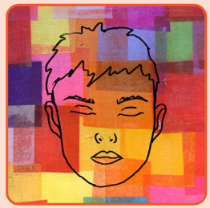
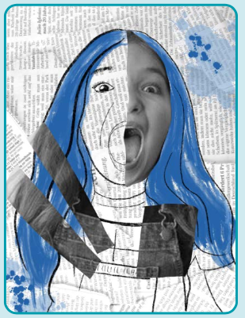
Art knowledge organiser Y5: painting and mixed media
Key knowledge
To combine materials for effect
To identify features of self-portaits
To use a range of mixed media
To explore how backgrounds can change the effect of the artwork
Key vocabulary | Meaning
collage | Cutting, arranging and sticking materials to a background
Mixed media | Art made from a combination of materials
Monoprint | A print that can only be made exactly the same once
Multi-media | Artwork that includes audio or video elements
photomontage | Collage made from photographs
Self-portrait | A portrait of the artist, by the artist
Prior knowledge | To know how to create tints and shades
 | To understand the importance of proportion
 | To use shading and tints to create 3D effects

Slide 2
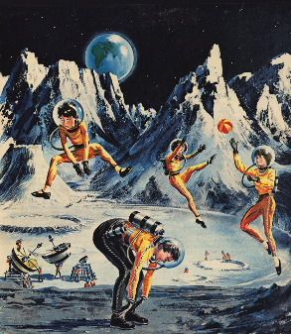
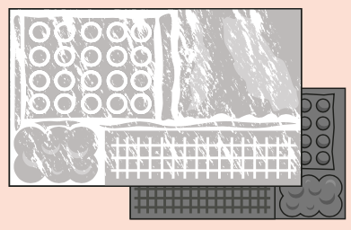
Art knowledge organiser Y5: drawing
Key knowledge
To explore the purpose and effect of imagery
To use a range of mark making and drawing to recreate an image
To know what collography is
To develop sketchbook ideas to create a futuristic image
To explore drawing on prints
Key vocabulary | Meaning
collagraphy | Printmaking process using texture to create interesting surfaces
imagery | A collection of visual images
propaganda | Information, that may be misleading, to promote a political cause
retrofuturism | A vision of what the future might look like (created pre-1960s)
technique | Applying a particular method of making something
Prior knowledge | To know how to use tone to create 3D drawings
 | To know how to incorporate mixed media into artwork
 | To know what proportion is

Slide 3
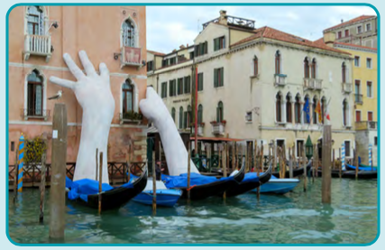
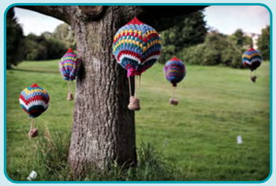

Art knowledge organiser Y5: Sculpture and 3D
Key knowledge
To know what installation art it
To investigate the impact of space with 3D art
To explore how everyday objects can become artwork
To create a concept using installation art
Key vocabulary | Meaning
atmosphere | The mood of an artwork
concept | The idea behind an artwork
location | The place where artwork is displayed
Performance art | Artwork that is an event rather than an object
scale | The size of an artwork
viewer | The people who look at/visit your installation
Prior knowledge | To know how to sculpt wire
 | To develop line and colour to draw 3D objects
 | To know the different materials we can use to make 3D models

