Slide 1
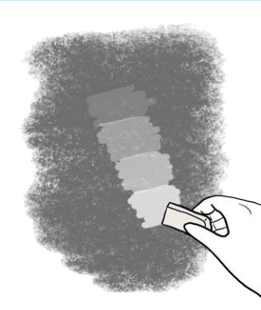
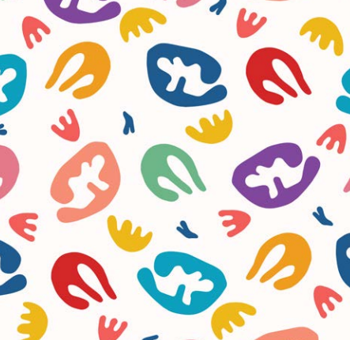
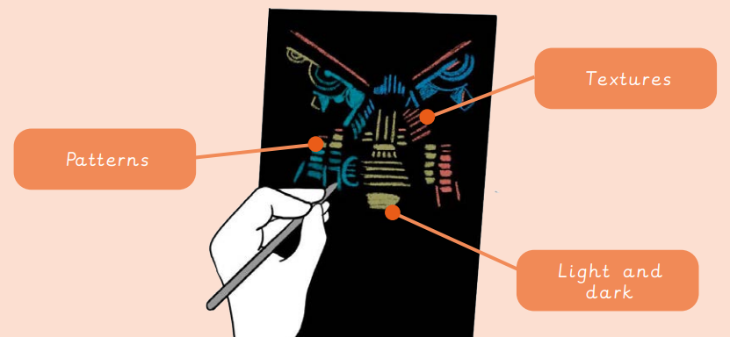
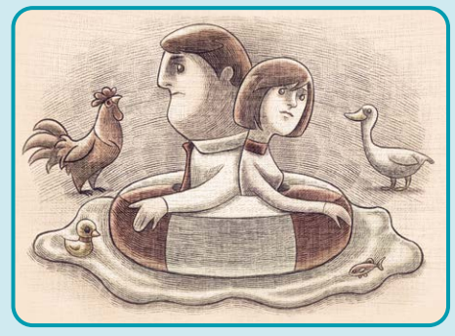
Art knowledge organiser Y4: drawing
Key knowledge
To know how to create a 3D effect using tone
To know how to draw objects in proportion to another
To incorporate mixed media into a piece of artwork
To know how to create a wax resist picture
To use engraving to create a print
Key vocabulary | Meaning
collaborate | Work in a group to create a shared artwork
engraving | Lines cut into a hard surface which is covered in ink and printed
Wax resist | Using wax to stop another material from sticking to a surface
proportion | How big one element of an artwork appears compared to the whole thing
Henri Matisse | An artist who used bold colours and shapes
print | Transferring an image onto another surface
Prior knowledge | To know how to use shape within a drawing
 | To know how to create tone with shading
 | To know what scale is within art

Slide 2
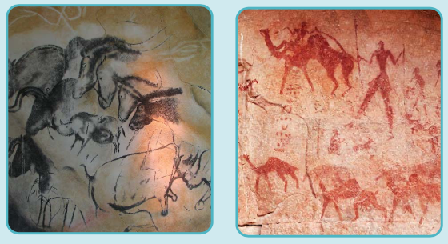
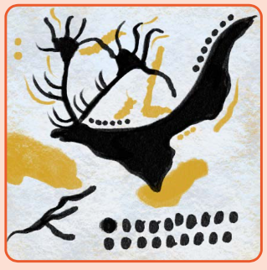
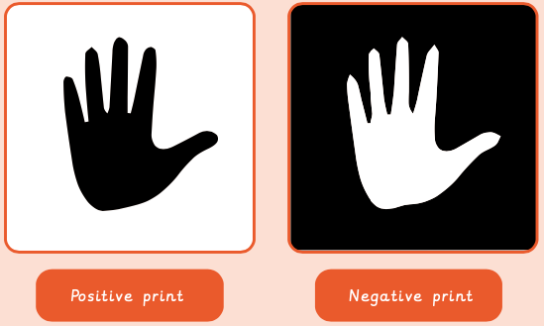
Art knowledge organiser Y4: painting and mixed media
Key knowledge
To know how to create tints and shades
To use tints and shades to create three-dimensional effects
To explore painting using different techniques
To know what still life is
To use proportion when drawing and painting
Key vocabulary | Meaning
hue | Describe an exact colour: sky blue, dark green, rose pink
proportion | How big a part of something looks compared to the rest of it
shadow | A dark area created when light is blocked
Still life | Artwork of a collection of things that don’t move
tint | Adding white to a colour
tone | How light or dark a colour is
Prior knowledge | To know how to use a range of mediums with painting
 | To identify how artwork was created prehistorically
 | To know what a pigment is

Slide 3
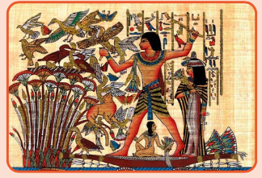
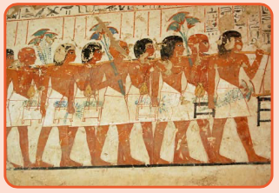
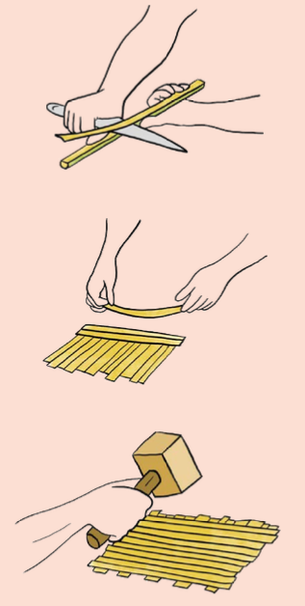
Art knowledge organiser Y4: Sculpture and 3D
Key knowledge
To use colour and line to change a shape from 2D to 3D
To explore using wire in sculpture
To understand how sculptures can be formed in different ways
To build a sculpture using recycled goods
Key vocabulary | Meaning
technique | Skills applied by an artist to produce a particular art form
pattern | A design in which shapes, colours or lines are repeated
Layout | The arrangement of different elements within a given space
Imagery | A collection of images from a range of art forms
Composition | Putting different elements together in a pleasing way
Colour | A feature of everything in the world that is seen through the way it reflects light
Prior knowledge | To know how to join clay together
 | To explore how to make impressions
 | To know how to use a range of tools with clay

